Slide 1


WINE QUALITY PREDICTION
By:
STATISTICAL SQUAD

Slide 2

Group Members
Asma Shaikh(05)
Nikita Rahi(28)
Pallavi Sawant(32)
Vedant Bhalekar(52)
Pradnya More(34)
Shubham Upadhyay(30)
Amruta Bandopadhyay(22)

Slide 3
1) DATASET 2)PROBLEM STATEMENT 3)OBJECTIVE 4)WHAT IS PRINCIPAL COMPONENT ANALYSIS (PCA) 5)CONCLUSION
Table of Contents

Slide 4
Input variables: 1.Fixed acidity 2.Volatile acidity 3.Citric acid 4.Residual sugar 5.Chlorides 6.Free sulfur dioxide 7.Total sulfar dioxide 8.Density 9.pH 10.Sulphates 11.Alcohol
Introduction:
Output variable:
Quality(score between 0 and 10)
Data set characteristic:
Multivariate
No. of observations:
1599
No. of attributes/variables:
12
Missing values:
N/A

Slide 5
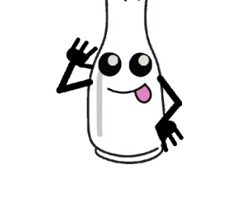
Terms in our data
(chemical ingredients of wine)
volatile acidity
alcohol
pH
citric acid
fixed acidity
chlorides
density
free sulfur dioxide
residual sugar
sulphates

Slide 6
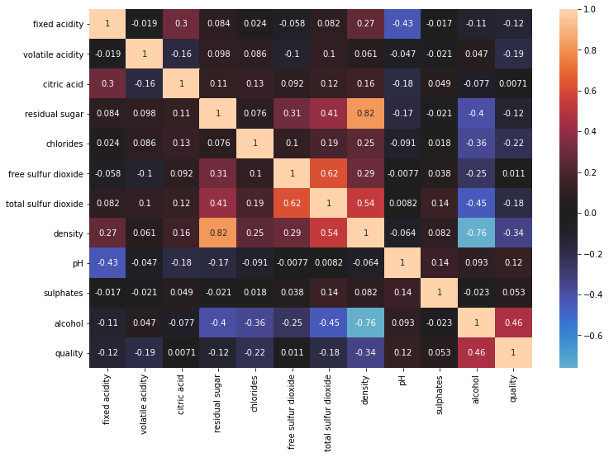
Correlation Matrix

Slide 7
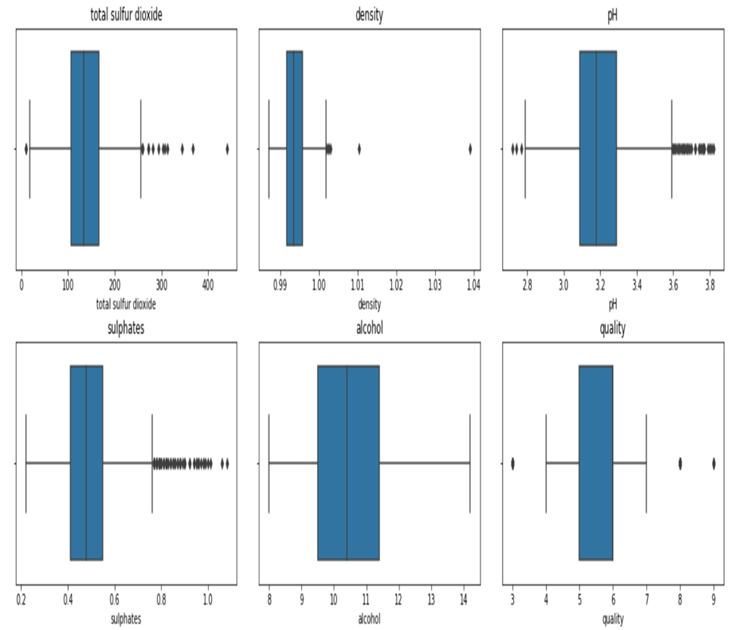

Slide 8
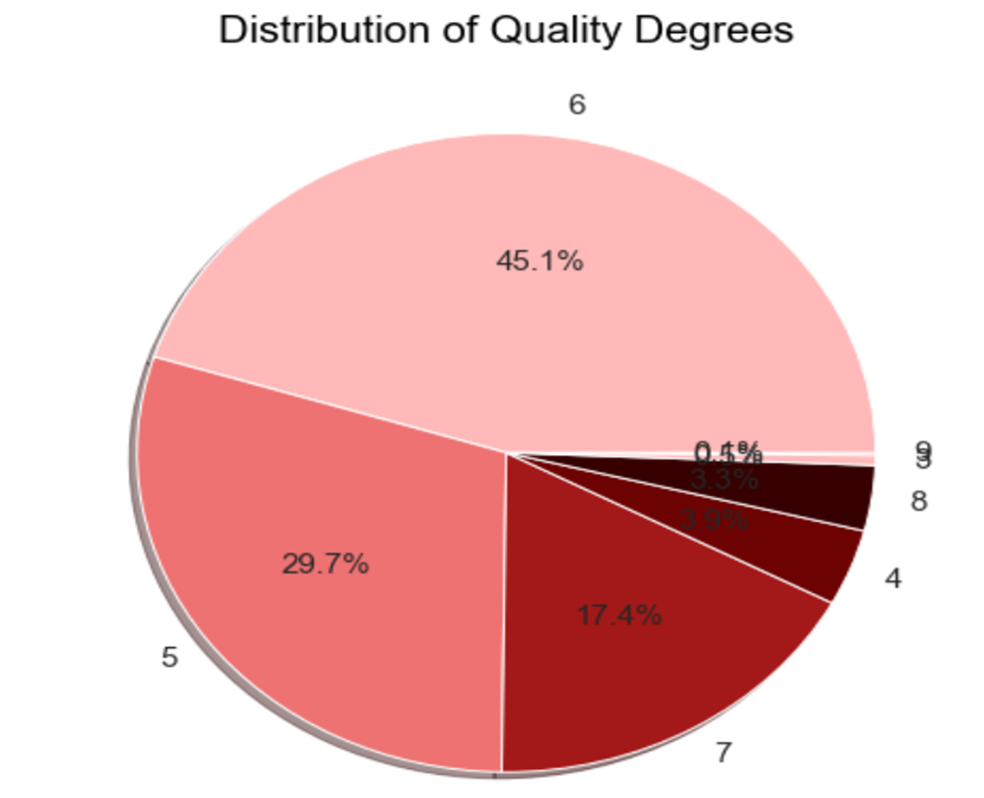
DISTRIBUTION OF QUALITY DEGREES

Slide 9
SKEWNESS:
fixed acidity | volatile acidity | citric acid | residual sugar | chlorides | free sulphur- dioxide
0.696100 | 1.641081 | 1.310601 | 1.333639 | 4.969076 | 1.566680
total sulphur- dioxide | density | pH | sulphates | alcohol | quality
0.456800 | 1.273318 | 0.455457 | 0.937853 | 0.450697 | 0.112004

Slide 10
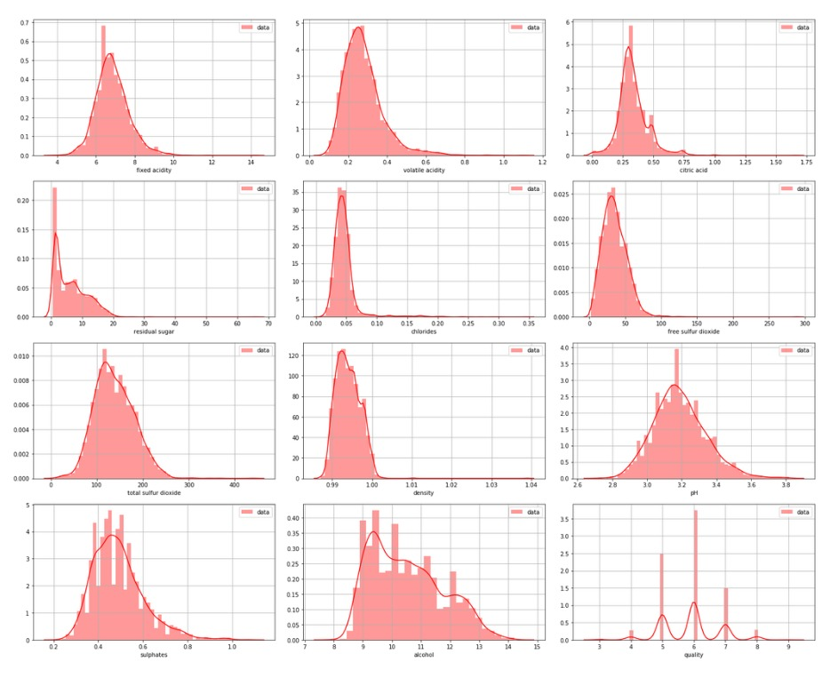

Slide 11
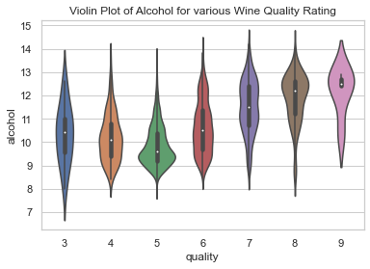
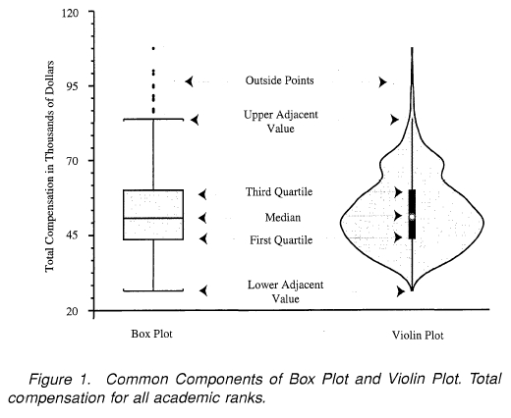
violin plots
In general, violin plots are a method of plotting numeric data.
In the violin plot, we can find the same information as in the box plots:
median
interquartile range
comparison of violin plot
And box plot:

Slide 12
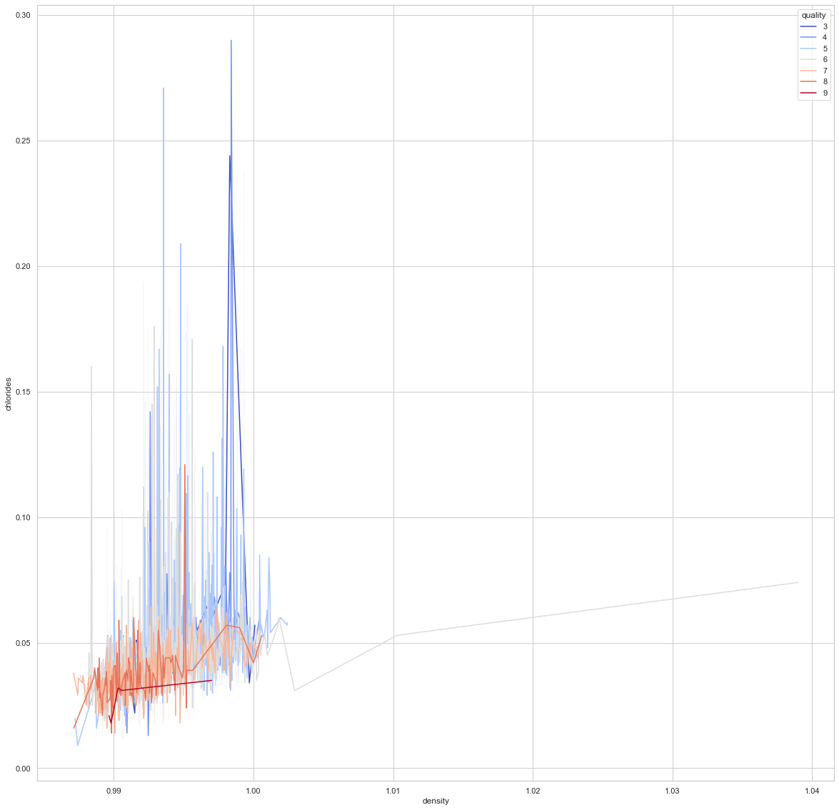
Relation of "chlorides" to "density"
regards to quality

Slide 13
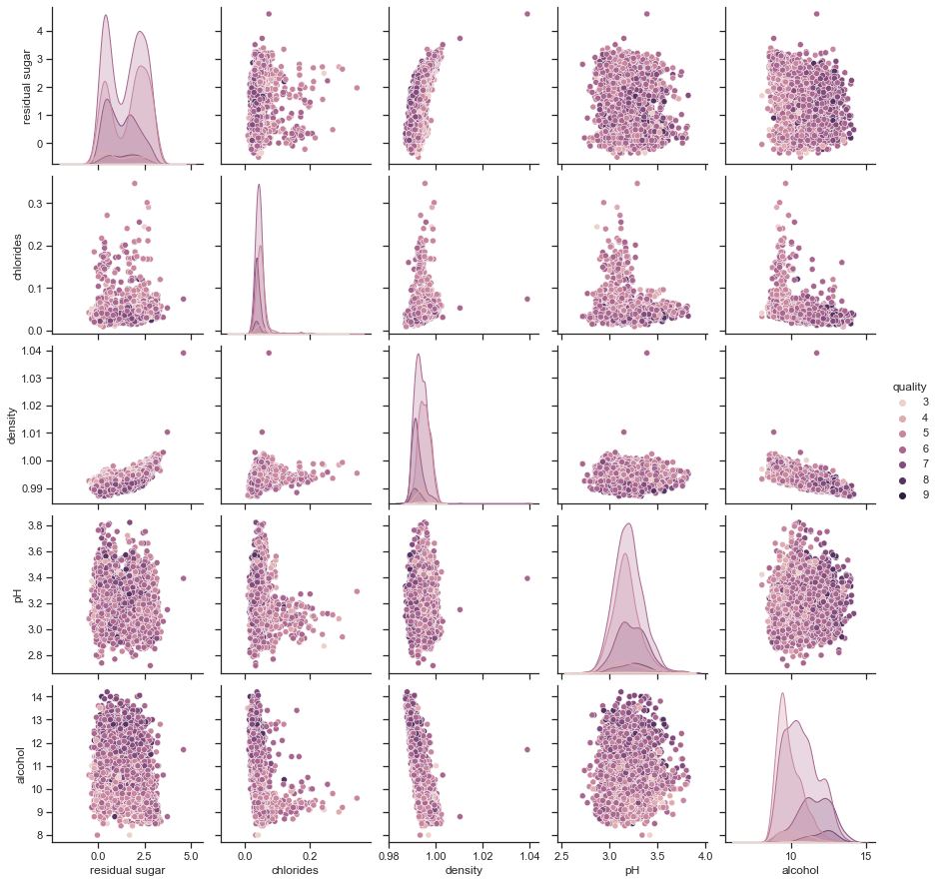
Relation of quality
with each component in data

Slide 14
PROBLEM STATEMENT
HOW THE QUALITY OF WINE DIFFERS WITH DIFFERENT CHARACTERISTICS?

Slide 15
OBJECTIVE
TO DETERMINE THE RELATION OF QUALITY OF WINE WITH THE INDEPENDENT VARIABLES.
WE WANT TO INVESTIGATE WHAT POPERTIES OF WINE DEFINE ITS QUALITY BY USING PCA AND WHICH OF THESE QUALITIES ARE REQUIRED TO PREDICT THE QUALITY OF WINE.

Slide 16
WHAT IS PCA?
WHY PCA??

Slide 17

Preparing data for Modelling
Splitting data into X and Y
Splitting data into training set
and test set
Perform feature scaling

Slide 18
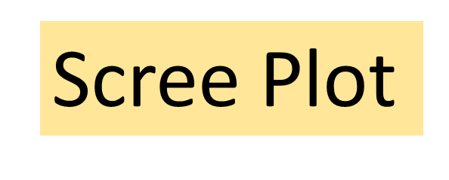
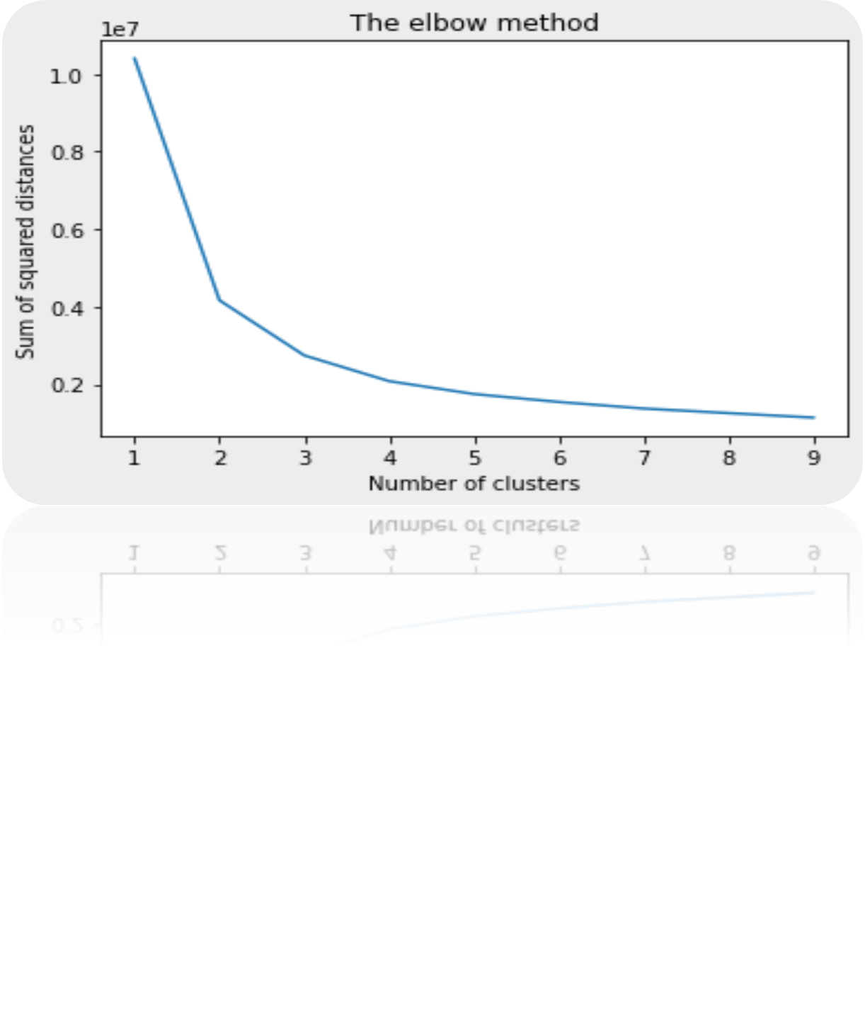
HOW MANY LATENT VARIABLES REQUIRED ?

Slide 19
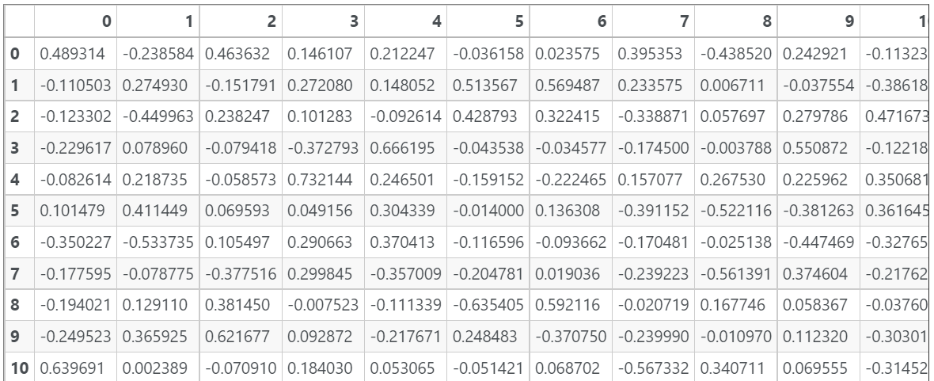
Applying PCA and Interpreting the results
It is the coefficient matrix. PC1 = (fixed acidity * 0.489314) + (volatile acidity * -0.238584) + … + (alcohol * -0.113232)

Slide 20
MODELLING
CLASSIFYING MODEL | ACCURACY SCORE
Logistic Regression | 53.75%
K-Means | 5.625%
Kneighbors Classifier | 42.81%
Random Forest Classifier | 59.68%
Linear Regression | 75%

Slide 21
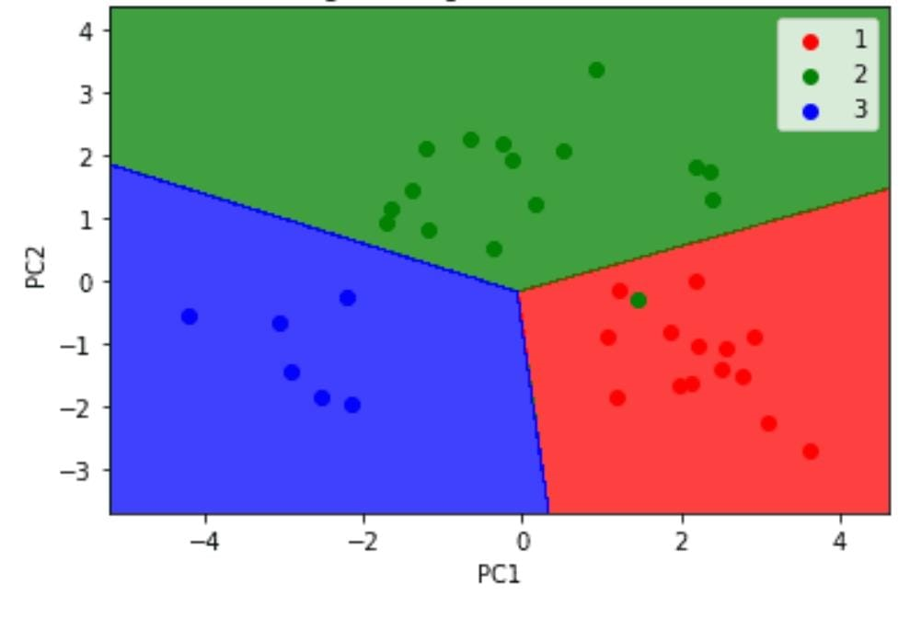
DATA VISUALISATION

Slide 22

CONCLUSION
We have seen several plots in which it is shown the relation of quality with other independent observed variables.
Correlation between quality and alcohol is maximum.
Linear regression fits the model with the accuracy score of 75% .

Slide 23
REFERENCES
https://www.mltut.com/wine-recommender-system-using-principal-component-analysis/
https://www.analyticsvidhya.com/blog/2022/03/multiple-linear-regression-using-python/
https://www.kaggle.com/code/gayatrirao98/wine-quality/notebook
https://www.geeksforgeeks.org/wine-quality-prediction-machine-learning/

Slide 24
Thank you

